Slide 1
NOISE IN IMAGES
Noise - a random variation in brightness or colour information and is frequently produced by technical limits of the image collection sensor or by improper environmental circumstances.
The presence of noise in an image might be additive or multiplicative.

Slide 2
Sources of noise
The following are the primary sources of noise in digital images: –
Environmental factors may have an impact on the imaging sensor.
Low light and sensor temperature may cause image noise.
Dust particles in the scanner can cause noise in the digital image.
Transmission channel interference.

Slide 3
Different Types of Noise
Gaussian noise
Salt and pepper noise
Poisson noise
Speckle noise

Slide 4
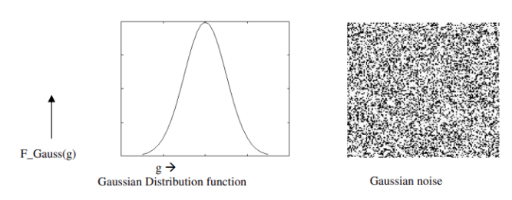
Gaussian Noise
Gaussian noise is a statistical noise having a probability density function (PDF) equal to the normal distribution.
Gaussian noise has a uniform distribution throughout the signal.
Additive white Gaussian noise is the most common application for Gaussian noise in applications

Slide 5
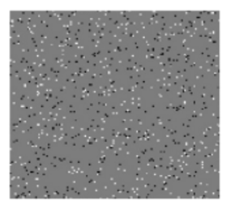
Salt and Pepper Noise
A common type of noise commonly seen in photographs.
It manifests as white and black pixels that appear at random intervals.
Errors in data transfer cause this form of noise to appear.
The use of a median filter, morphological filter, or contra harmonic mean filter is an effective noise eradication strategy for this type of noise.
In situations when quick transients, such as improper switching, occur, salt and pepper noise creeps into images.

Slide 6
Poisson Noise
Poisson Noise:
The appearance of this noise is seen due to the statistical nature of electromagnetic waves such as x-rays, visible lights and gamma rays.
These rays are are injected in patient’s body from its source, in medical x rays and gamma rays imaging systems.
Fluctuation of photons causes this noise.
Result gathered image has spatial and temporal randomness. This noise is also called as quantum (photon) noise or shot noise.

Slide 7
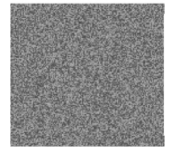
Speckle Noise
Speckle noise is multiplicative noise.
This reduces image quality by giving images a backscattered wave appearance caused by many microscopic dispersed reflections flowing through internal organs.
This makes it more difficult for the observer to distinguish fine details in the images.

Slide 8
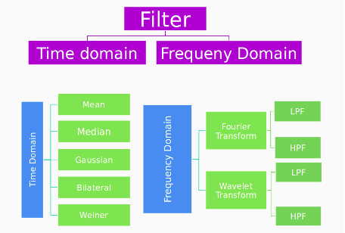
Noise filtering in digital image
There are different types of image noise filters.
Time Domain Filters
Frequency Domain Filters

Slide 9
FILTER TYPES
Gaussian Filter:
In image processing, a Gaussian blur (also known as Gaussian smoothing) is the result of blurring an image by a Gaussian function.
It is a widely used effect in graphics software, typically to reduce image noise and reduce detail.
Mean Filter:
Mean filter is a simple sliding window that replace the center value with the average of all pixel values in the window. The window or kernel is usually a square but it can be of any shape.
Median Filter:
Mean filter is a simple sliding window that replace the center value with the Median of all pixel values in the window. The window or kernel is usually a square but it can be of any shape.

Slide 10
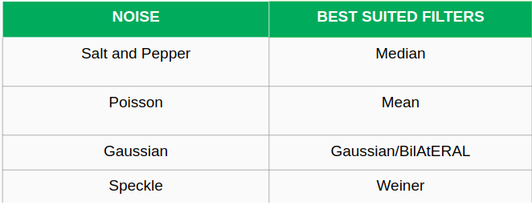
FILTER TYPES
Bilateral Filter:
Bilateral filter uses Gaussian Filter but it has one more multiplicative component which is a function of pixel intensity difference.
It ensures that only pixel intensity similar to that of the central pixel is included in computing the blurred intensity value. This filter preserves edges.

